Slide 1
Capstone Project-3
HEALTH INSURANCE CROSS SELL PREDICTION Kartika Sharma

Slide 2

Is Insurance a good Idea?
Problem Statement
EDA
Feature Selection
Preparing dataset
for modelling
SMOTE
Model Fitting
Evaluation
Hyperparameter tuning

Slide 3
Rest Insured
Building a model to predict whether a customer would be interested in Vehicle Insurance is extremely helpful for the company because it can then accordingly plan its communication strategy to reach out to those customers and optimize its business model and revenue.
Now, in order to predict, whether the customer would be interested in Vehicle insurance, you have information about demographics (gender, age, region code type), Vehicles (Vehicle Age, Damage), Policy (Premium, sourcing channel) etc.

Slide 4
Data Summary
id : Unique ID for the customer
Gender : Gender of the customer
Age : Age of the customer
Driving_License 0 : Customer does not have DL, 1 : Customer already has DL
Region_Code : Unique code for the region of the customer
Previously_Insured : 1 : Customer already has Vehicle Insurance, 0 : Customer doesn't have Vehicle Insurance
Vehicle_Age : Age of the Vehicle

Slide 5
Data Summary
Vehicle_Damage :1 : Customer got his/her vehicle damaged in the past. 0 : Customer didn't get his/her vehicle damaged in the past.
Annual_Premium : The amount customer needs to pay as premium in the year
PolicySalesChannel : Anonymized Code for the channel of outreaching to the customer ie. Different Agents, Over Mail, Over Phone, In Person, etc.
Vintage : Number of Days, Customer has been associated with the company
Response : 1 : Customer is interested, 0 : Customer is not interested

Slide 6
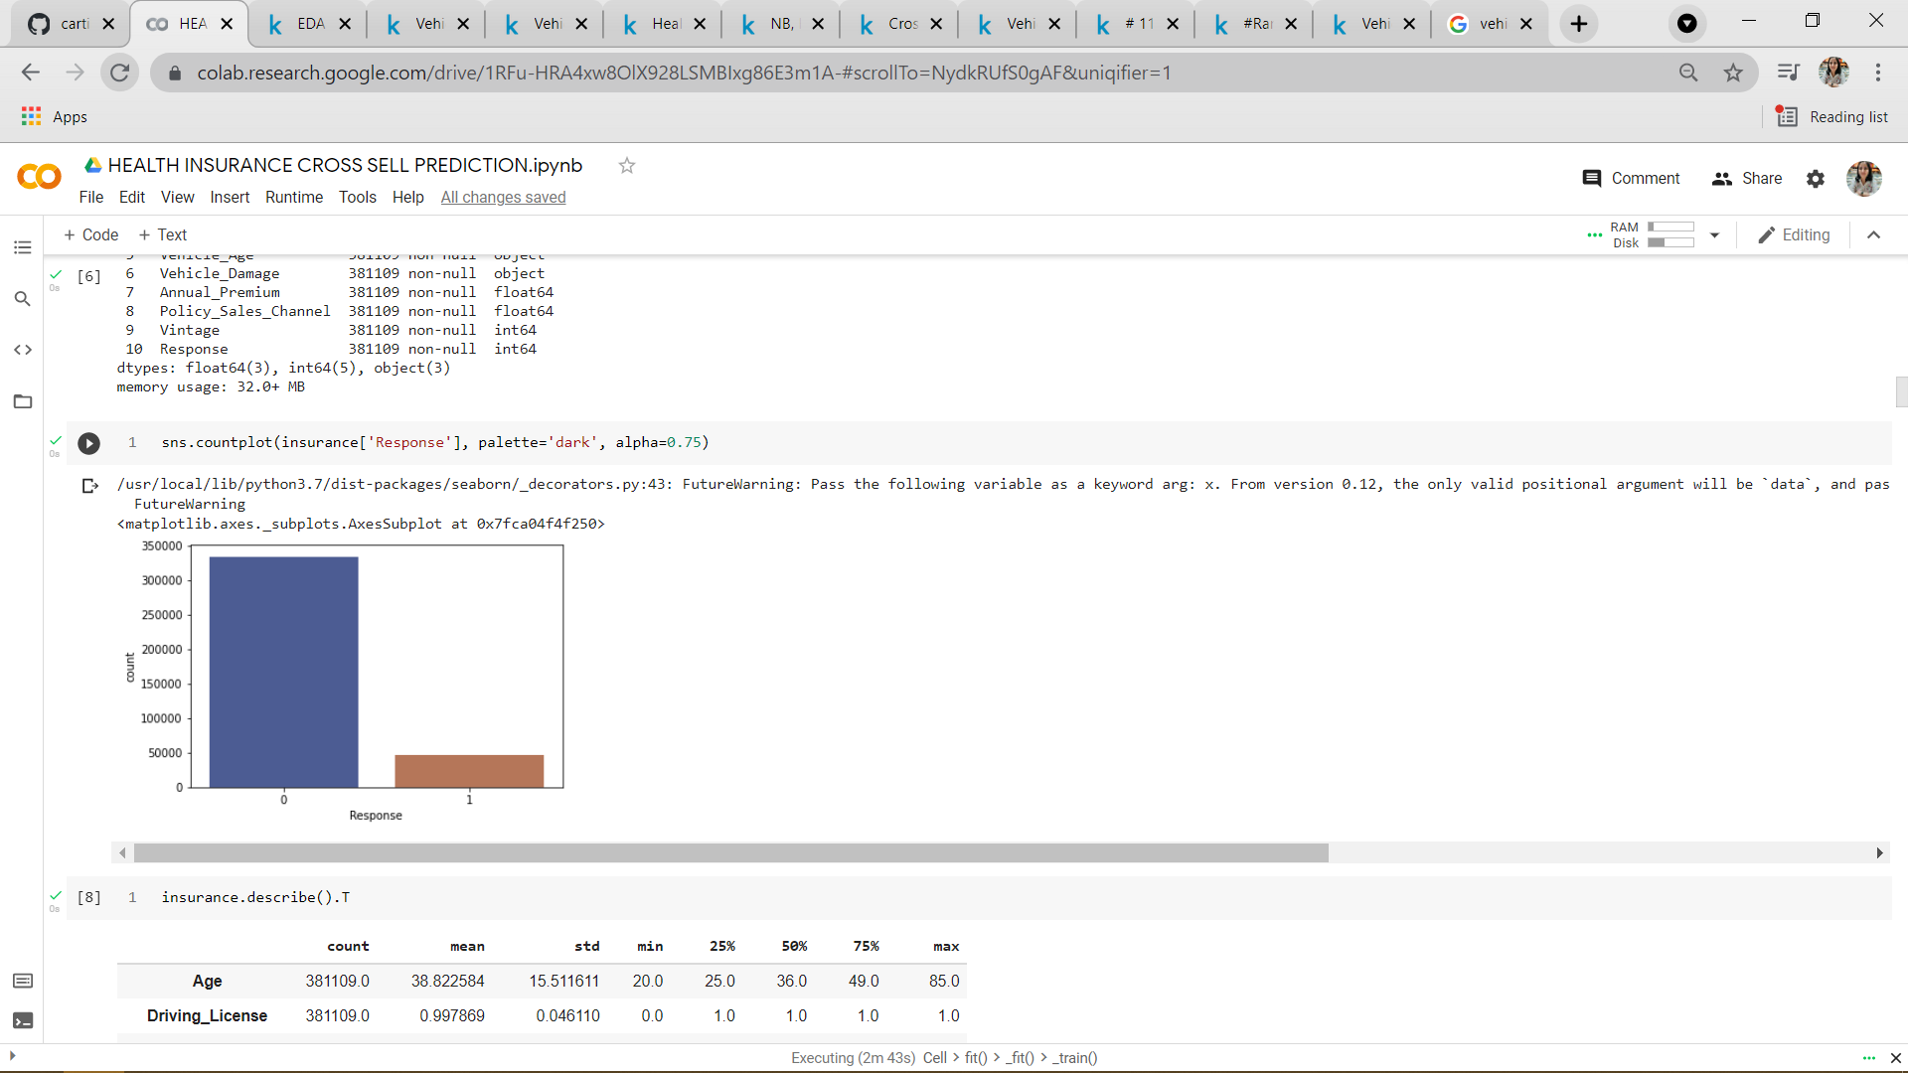
EDA (Target)
We analysed that response 1 values
are too low to give desired results
i.e is has a high possibility
of giving false positives
Countplot shows that response 1
is less than 5k and other one
around 3.5 lakhs

Slide 7
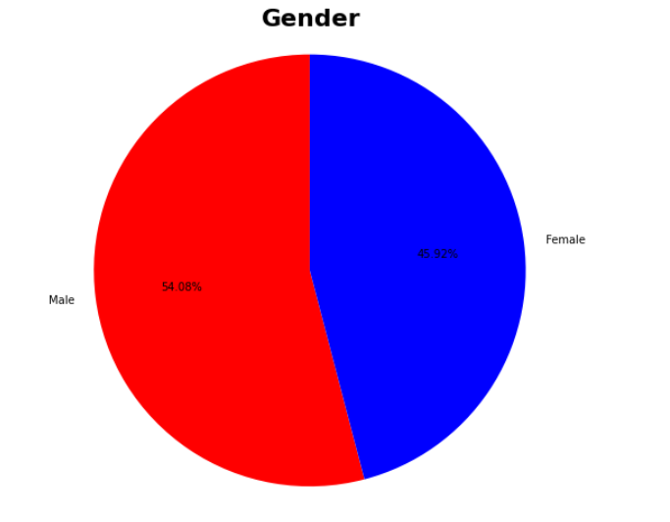
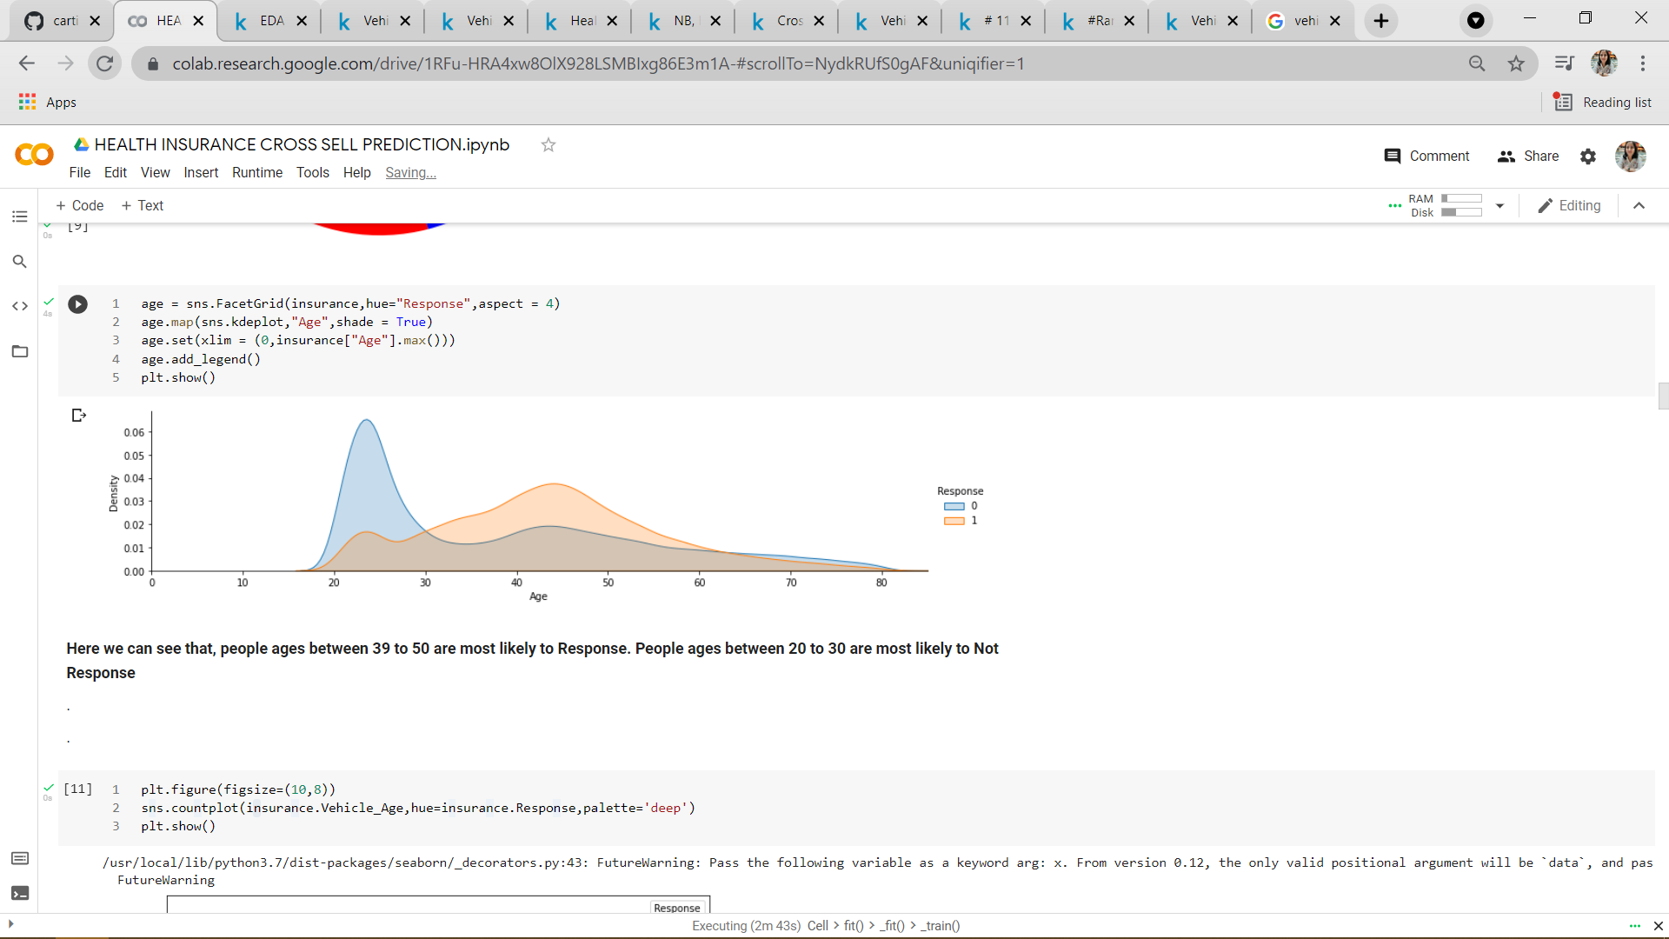
EDA

Slide 8
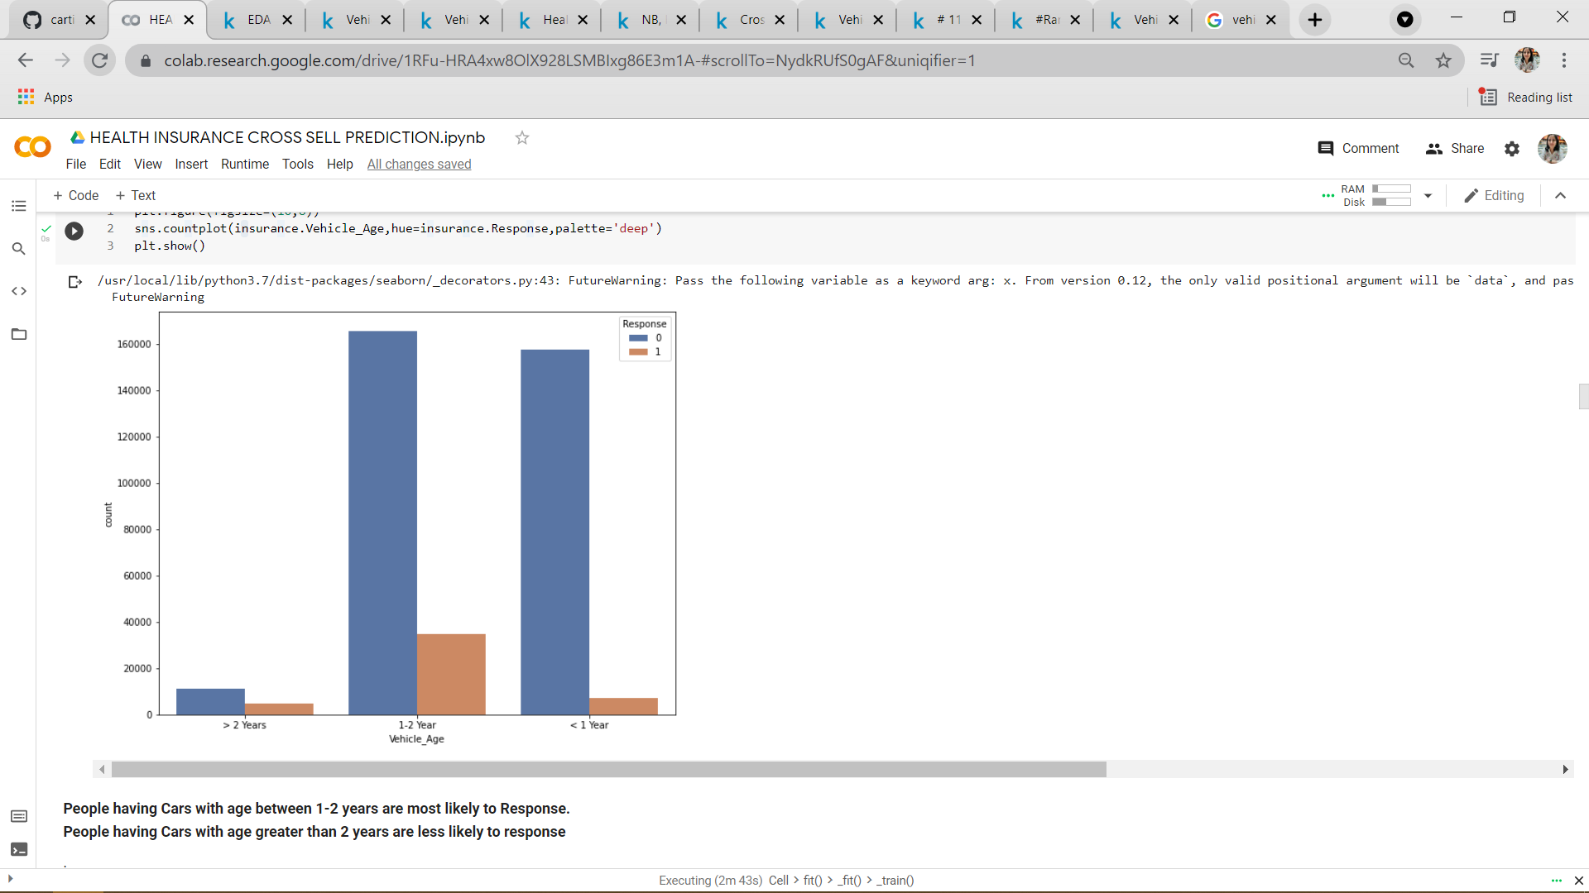
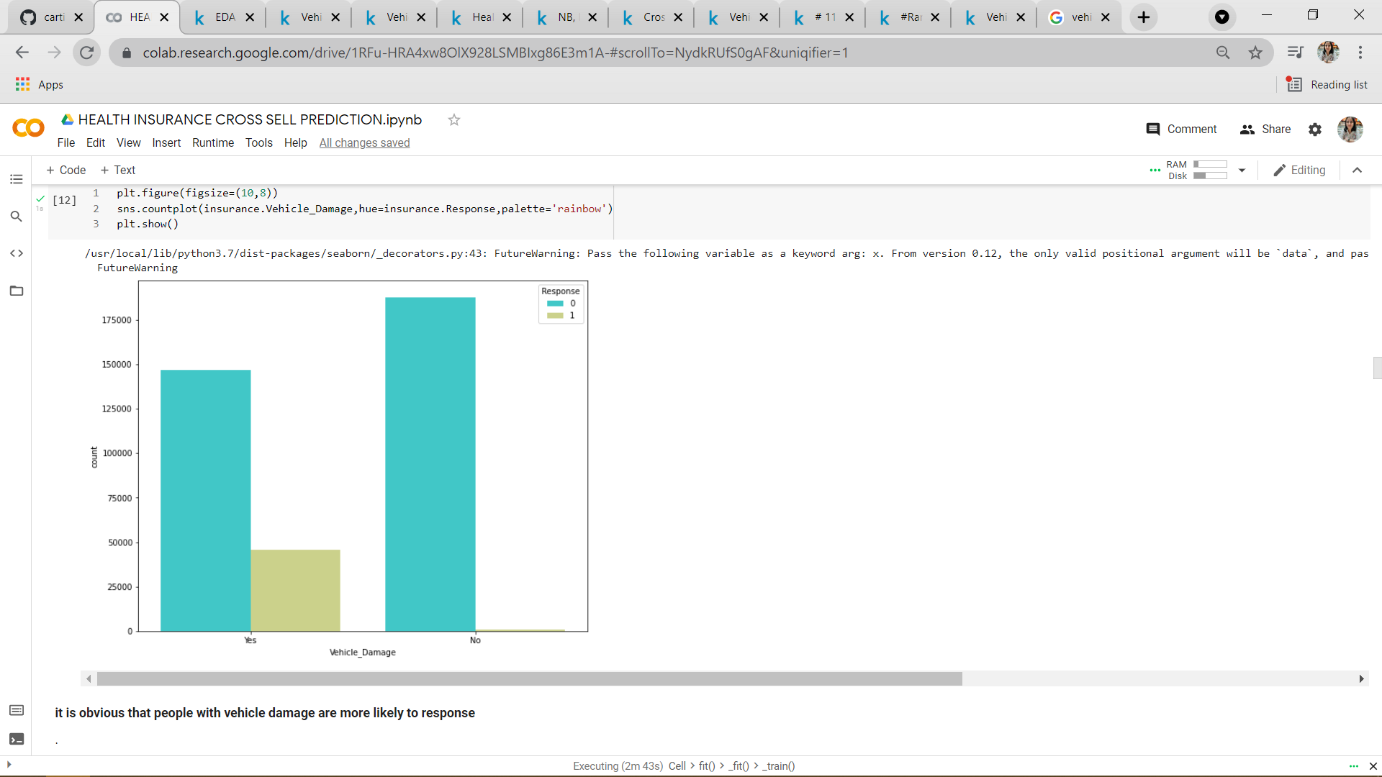
EDA

Slide 9
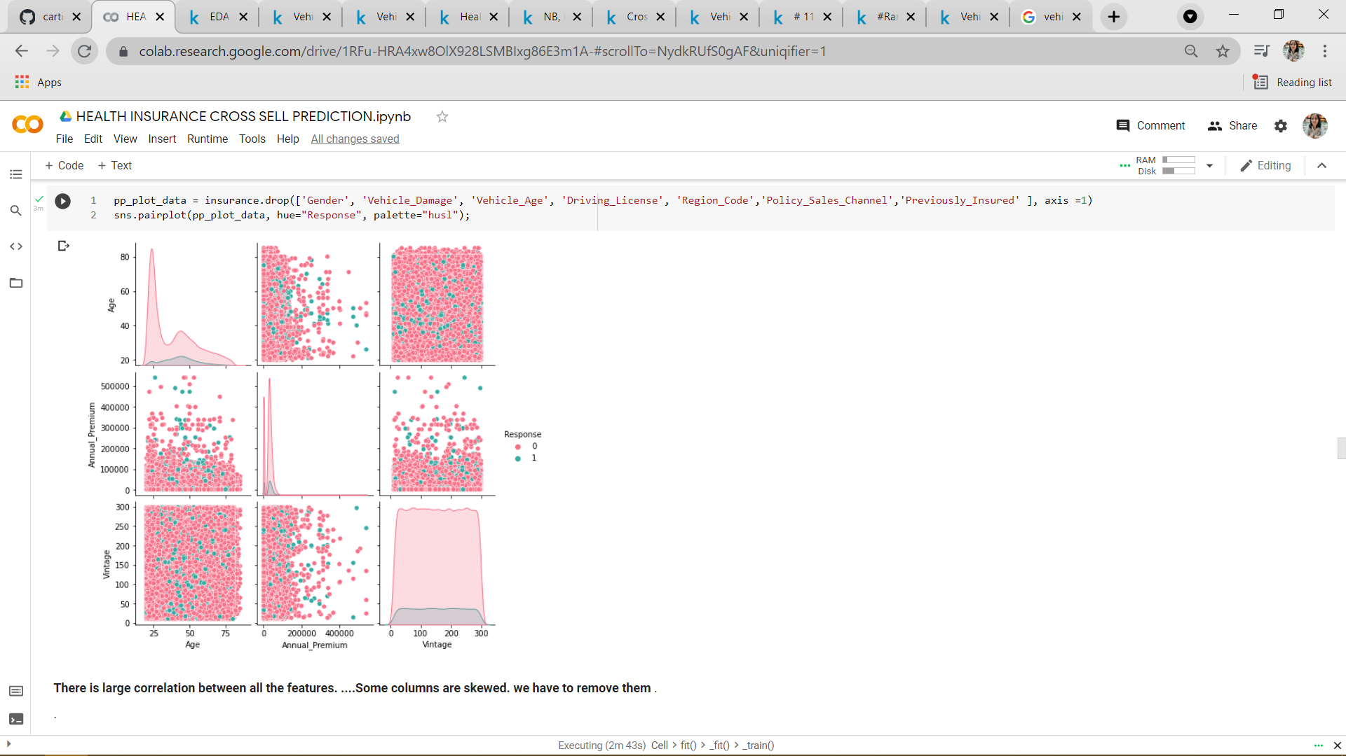
CORRELATION(EDA)

Slide 10
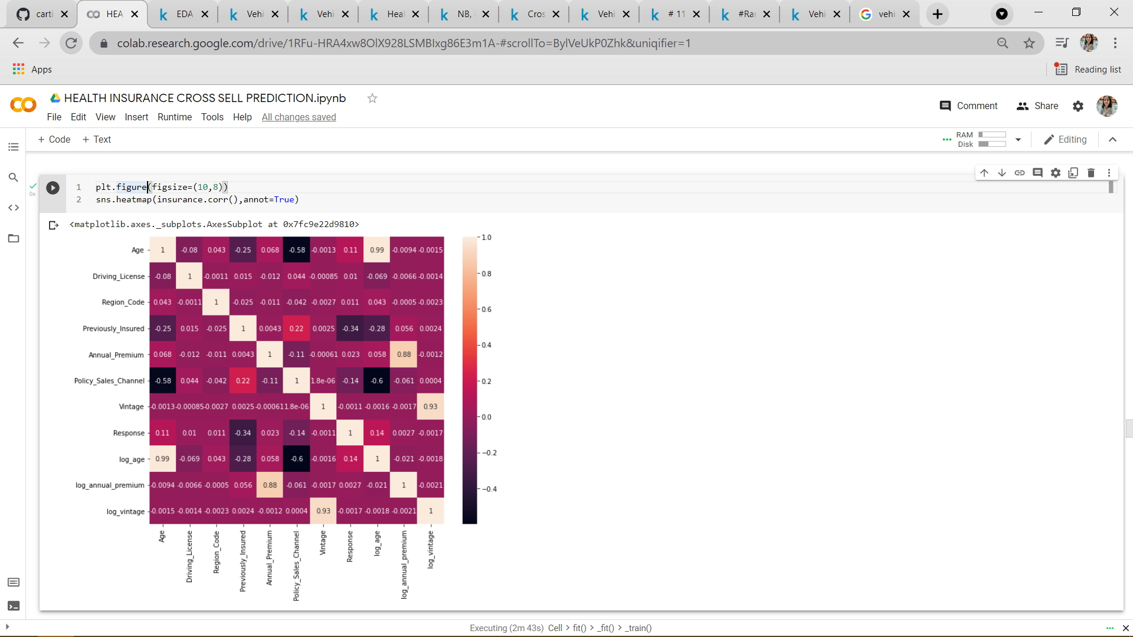
CORRELATION

Slide 11
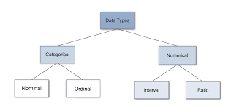
CATEGORICAL VARIABLES
Numerical Data
Ordinal Variables
Nominal Variables

Slide 12
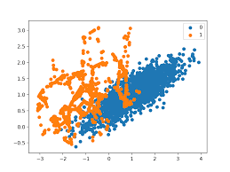
SMOTE
SMOTE stands for Synthetic Minority Oversampling Technique. This is a statistical technique for increasing the number of cases in your dataset in a balanced way. The module works by generating new instances from existing minority cases that you supply as input

Slide 13
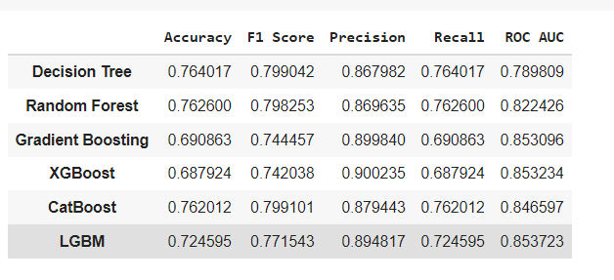
EVALUATION

Slide 14
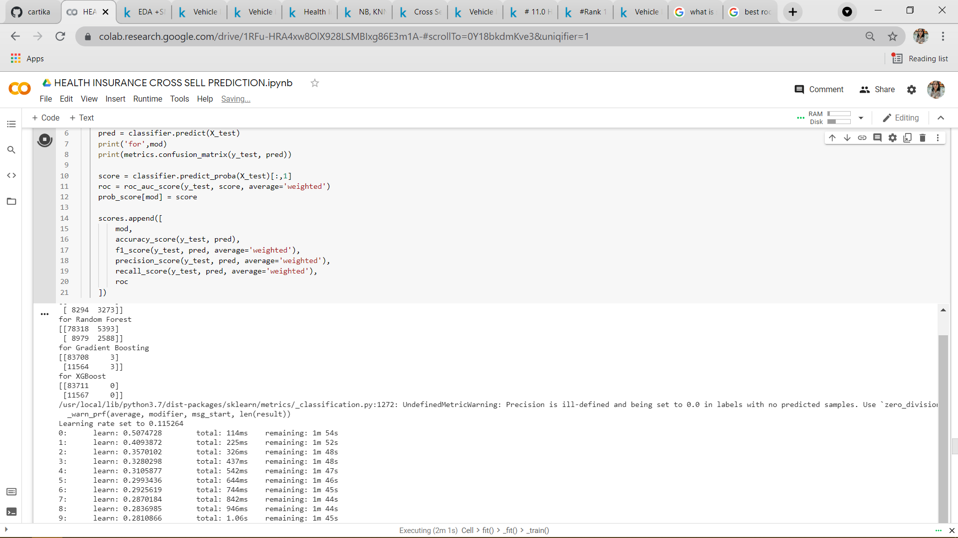
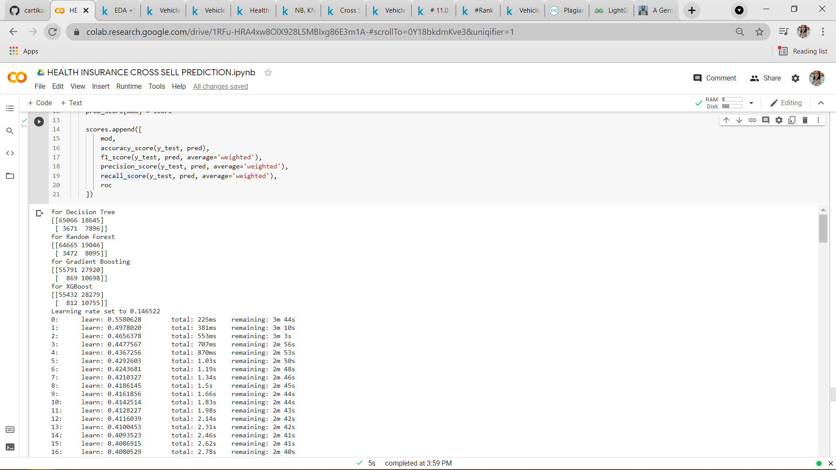
Lots of Confusion
BEFORE SMOTE VS AFTER SMOTE

Slide 15
THINGS THAT DIDN’T WORK
Removing outliers
Without SMOTE performance was dull
Log normalization didn’t work
No improvement with hyperparameters

Slide 16
Conclusion
We observed that Hyperparameter tuning with randomized search CV did not improve the model performance
We are sticking to our original random forest, LGBM and catboost model as it gave food accuracy on both Responses(0 and 1) and performed well on other matrices too
Random Forest ROC AUC =82% and ACCURACY = 76%
ACCURACY = 88% without SMOTE
Outlier removal gave worst results

Slide 17
Q & A

